Slide 1
HIGHER-ORDER COMPONENTS
By Volodymyr Karanevych

Slide 2
AGENDA
Higher-Order Components
State hoisting
Controlled input

Slide 3
WHAT IS HIGHER-ORDER COMPONENTS?

Slide 4
INTRODUCTION
Concretely, a higher-order component is a function that takes a component and returns a new component.

Slide 5
Let's imagine that we have a counter component.

Slide 6
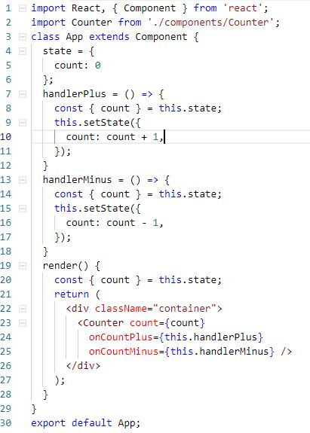
App.jsx

Slide 7
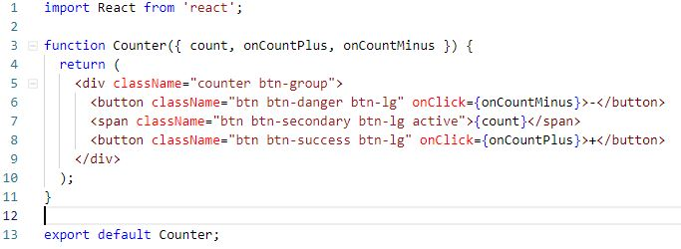
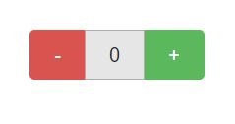
Counter.jsx

Slide 8
What if we want to show previous state but we won’t to change our existing components?

Slide 9
USE HOCS FOR CROSS-CUTTING CONCERNS

Slide 10
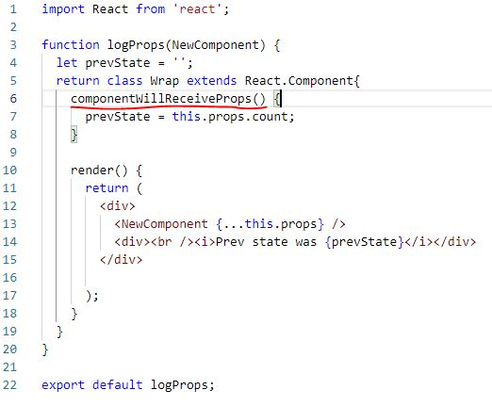
logProps.jsx

Slide 11
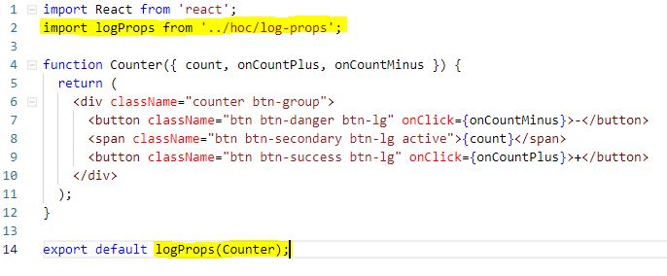
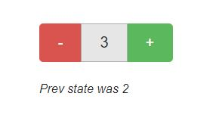
Counter.jsx

Slide 12
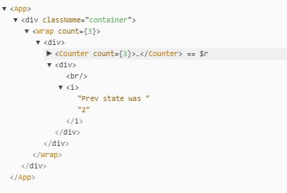
Browser console

Slide 13
Note that a HOC doesn’t modify the input component, nor does it use inheritance to copy its behavior. Rather, a HOC composes the original component by wrapping it in a container component.
A HOC is a pure function with zero side-effects.
And that’s it!

Slide 14
STATE HOISTING

Slide 15
WHAT IS STATE HOISTING?
One of the React patterns is called state hoisting.
As we know stateless functions don’t hold state and events are changes in state. Their data needs to be passed to stateful container components parents.
This is a perfect situation to use state hoisting and it’s accomplished by passing a callback from a container component to a child component.

Slide 16
Let's see how it works on an example test components that I've wrote.

Slide 17
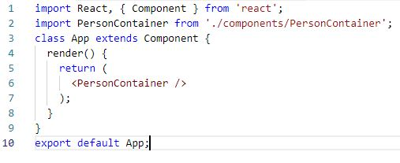
App.jsx

Slide 18
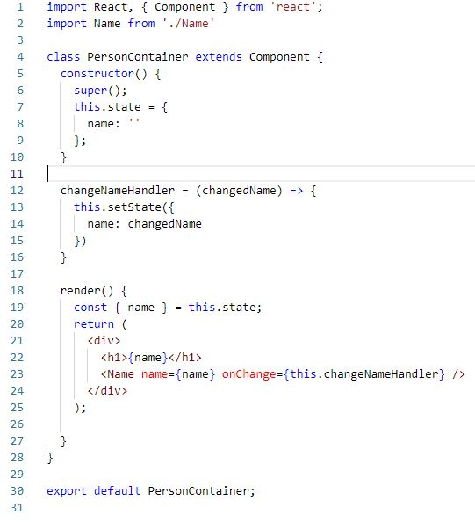
PersonContainer.jsx

Slide 19
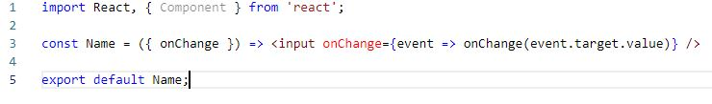
Name.jsx

Slide 20
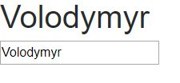
As result we can see that it works.

Slide 21
CONTROLLED INPUT

Slide 22
A controlled input accepts its current value as a prop, as well as a callback to change that value.
In React you can’t change input value directly.
So we must use handlers to do it.

Slide 23
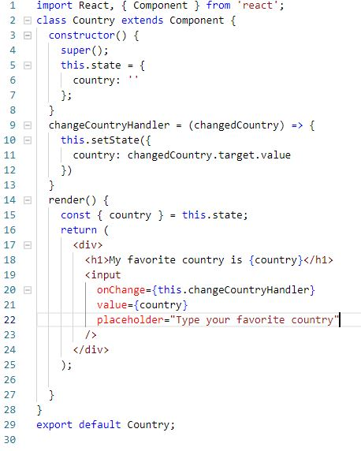
Country.jsx

Slide 24
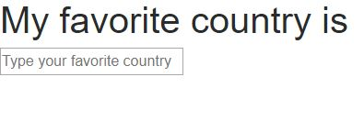
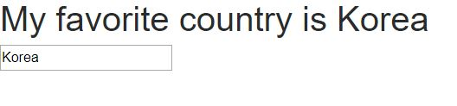
As result we can see text on our screen and changed value inside input.

Slide 25
USED MATERIALS
https://reactjs.org/docs/higher-order-components.html
https://medium.com/quick-bytes/hoisting-state-in-react-and-why-7dc5c832e35d
https://medium.com/@leonardobrunolima/react-tips-state-hoisting-c77c3cc78719
https://reactjs.org/docs/forms.html
https://goshakkk.name/controlled-vs-uncontrolled-inputs-react/

Slide 26
QUESTIONS?

Slide 27
THANK YOU

